Slide 1
Apache Kafka
Max Petrov,
ITMO University, Saint Petersburg, Russia
max93petrov@gmail.com
Saint Petersburg, Finland, 2017

Slide 2
Agenda
Introduction
Usage cases
Features
Architecture
Data model
Practice
Download, setup, run
Default producer and consumer
Python producer and Python/Java/Scala Spark consumers
Multi-node setup, run

Slide 3
Introduction
Apache Kafka is an open-source stream processing platform developed by the LinkedIn and supports Apache Software Foundation written in Scala and Java.
Kafka is used for building real-time streaming apps.
It is horizontally scalable, fault-tolerant, fast.

Slide 4
Usage cases
General: Real-time data processing systems
Example: Traffic Data Monitoring Application

Slide 5
Features
Feature | Description
Scalability | Distributed system scales easily
Reliability, Durability Fault-Tolerance | Replicates data, persist data on disk, and automatically balances consumers in failure case
Performance | High throughput and low latency ~100 000 messages/sec, ~ 1 sec for one node

Slide 6
Performance

Slide 7
Performance
Notes:
https://softwaremill.com/mqperf/

Slide 8
Architecture
Notes:
Zookeeper – you start this before Kafka. ZooKeeper is used for managing, coordinating Kafka broker. So each node in the cluster knows when a new broker joined, a Broker died, a topic was removed or a topic was added,
There are 2 types of applications witch interacts with kafka cluster: Producers and Consumers
Producers – can be data collectors6 for example crawler systems, or data generator and others.
Consumers – applications that subscribe to topics; for example, a web application, but usualy it is streaming frameworks, like spark streaming, flink, storm.
Kafka cluster it is not master-worker model, all nodes in a cluster call Brokers and it all equals
Each broker can contain special categories or types of messages called Topics. It could be something like “twitter_messages” or “vk_messages”.
Each Topic can splited by some number, and it will be partition entity
It can be noticed that for one topic, partitions can be located on different brokers to archive concurrent reading

Slide 9
Topic partitions
Concurrent writes to the topic for producers
Data sortied by time
Partitions can be different lengths
Notes:
For Streaming and realtime apps a new data processing important, old data not so much
And producers pushing data to partitions in parallel
Partitions can be different lengths and sorted by time

Slide 10
Fast sequential disk reading
Notes:
For Streaming and realtime apps a new data processing important, old data not so much
And producers pushing data to partitions in parallel
Partitions can be different lengths and sorted by time

Slide 11
Partition offsets
Producers writes to the tail of the partition
Consumers have independent offsets
Consumer can save (commit) offsets while reading and continue reading from saved offset if it fall down to archive exactly once semantic
Notes:
Lets look at Partition
Each Partition document have id it is called offset, simple long value
Actually it is set of offsets, for each consumer
Producers writes to the tail of the partition and increases offsets incrementally
Consumers can use offsets like array index, but usually it sequentially pulling data from latest offset (reading only new data)
Consumer also can save (commit) offsets while reading and continue reading from saved offset if it fall down to archive exactly once semantic
Коммит оффеста нужен для реализации различных типов семантики: раз exactly once, atleast once

Slide 12
Practice

Slide 13
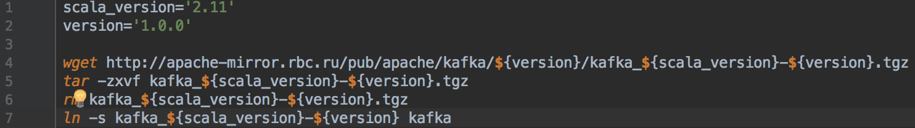
Download and extract
Configuration
Change parameters:
listeners=PLAINTEXT://127.0.0.1:9092
advertised.listeners=PLAINTEXT://127.0.0.1:9092
zookeeper.connect=127.0.0.1:2181
Notes:
scala_version='2.11'
kafka_version='1.0.0'
wget http://apache-mirror.rbc.ru/pub/apache/kafka/${kafka_version}/kafka_${scala_version}-${kafka_version}.tgz
tar -zxvf kafka_${scala_version}-${kafka_version}.tgz
rm kafka_${scala_version}-${kafka_version}.tgz
ln -s kafka_${scala_version}-${kafka_version} kafka

Slide 14
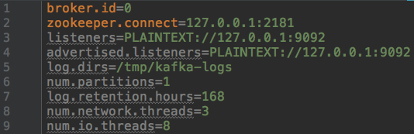
Important configuration parameters
Notes:
zookeeper.connect is used to zoo connect
listeners is what the broker will use to create server sockets.
advertised.listeners is what clients will use to connect to the brokers.
The two settings can be different if you have a "complex" network setup (with things like public and private subnets and routing in between).

Slide 15
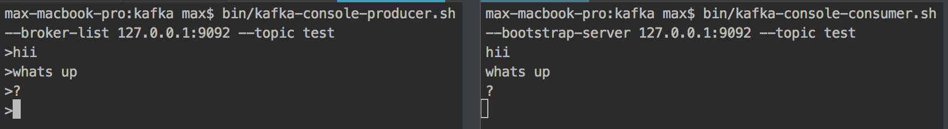
Run
Default producer and consumer
Notes:
run:
cd kafka
bin/zookeeper-server-start.sh config/zookeeper.properties bin/kafka-server-start.sh config/server.properties
advanced level:
nohup kafka/bin/zookeeper-server-start.sh kafka/config/zookeeper.properties > zoo.log &
sleep 1s
nohup kafka/bin/kafka-server-start.sh kafka/config/server.properties > kafka.log &
status:
ps aux | grep -v grep | grep 'kafka.Kafka\|QuorumPeerMain' | awk '{print $2}' | xargs kill -9

Slide 16
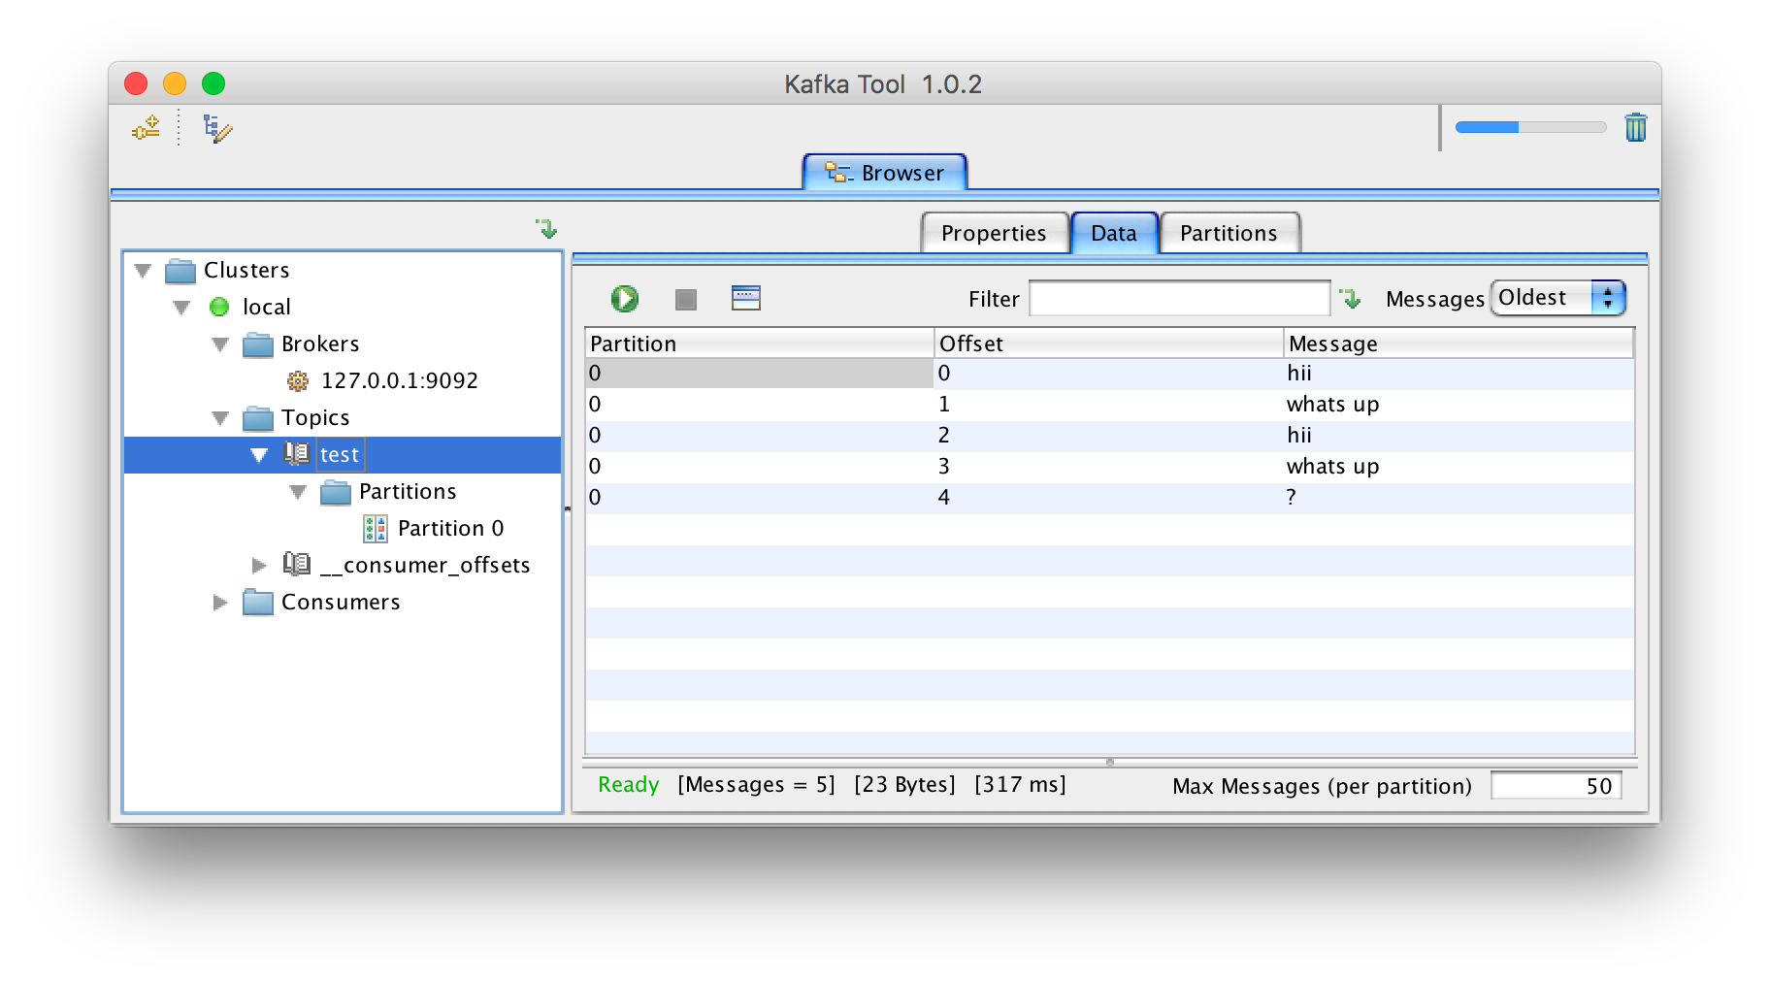
Kafkatool

Slide 17
Clients
C/C++, Python, Go, Erlang, .NET, Clojure,
Ruby, Node.js, Perl, PHP, Rust, Clojure, Swift
All opensource
Sync/asynchronous
Look at python, java, apache spark clients

Slide 18
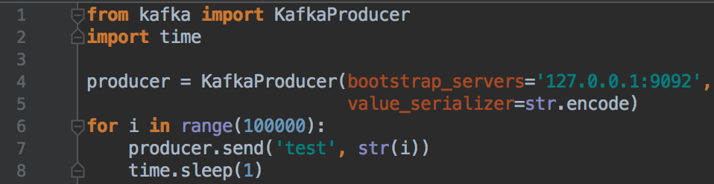
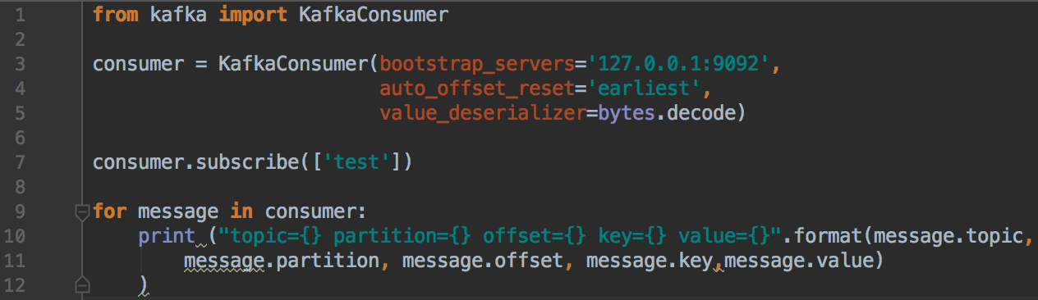
Python
Installation: pip install kafka-python
Producer
Consumer
Notes:
from kafka import KafkaConsumer consumer = KafkaConsumer(bootstrap_servers='127.0.0.1:9092', auto_offset_reset='earliest', value_deserializer=bytes.decode) consumer.subscribe(['test']) for message in consumer: print ("topic={} partition={} offset={} key={} value={}".format(message.topic, message.partition, message.offset, message.key,message.value) )
from kafka import KafkaProducer import time producer = KafkaProducer(bootstrap_servers='127.0.0.1:9092', value_serializer=str.encode) for i in range(100000): producer.send('test', str(i)) time.sleep(1) print("Producer ended")

Slide 19
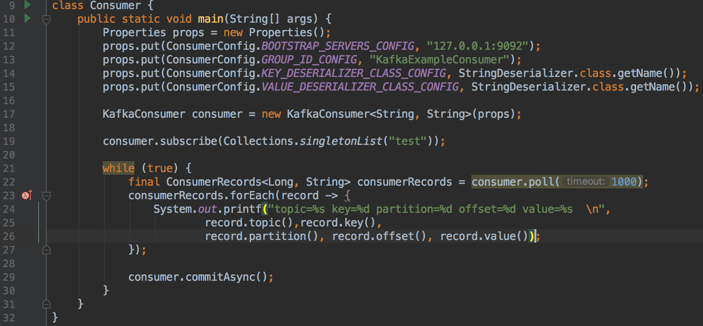
Java consumer
Notes:
import org.apache.kafka.clients.consumer.ConsumerConfig; import org.apache.kafka.clients.consumer.ConsumerRecords; import org.apache.kafka.clients.consumer.KafkaConsumer; import org.apache.kafka.common.serialization.StringDeserializer; import java.util.Collections; import java.util.Properties; class Consumer { public static void main(String[] args) { Properties props = new Properties(); props.put(ConsumerConfig.BOOTSTRAP_SERVERS_CONFIG, "127.0.0.1:9092"); props.put(ConsumerConfig.GROUP_ID_CONFIG, "KafkaExampleConsumer"); props.put(ConsumerConfig.KEY_DESERIALIZER_CLASS_CONFIG, StringDeserializer.class.getName()); props.put(ConsumerConfig.VALUE_DESERIALIZER_CLASS_CONFIG, StringDeserializer.class.getName()); KafkaConsumer consumer = new KafkaConsumer<String, String>(props); consumer.subscribe(Collections.singletonList("test")); while (true) { final ConsumerRecords<Long, String> consumerRecords = consumer.poll(1000); consumerRecords.forEach(record -> { System.out.printf("topic=%s key=%d partition=%d offset=%d value=%s \n", record.topic(),record.key(), record.partition(), record.offset(), record.value()); }); consumer.commitAsync(); } } }

Slide 20
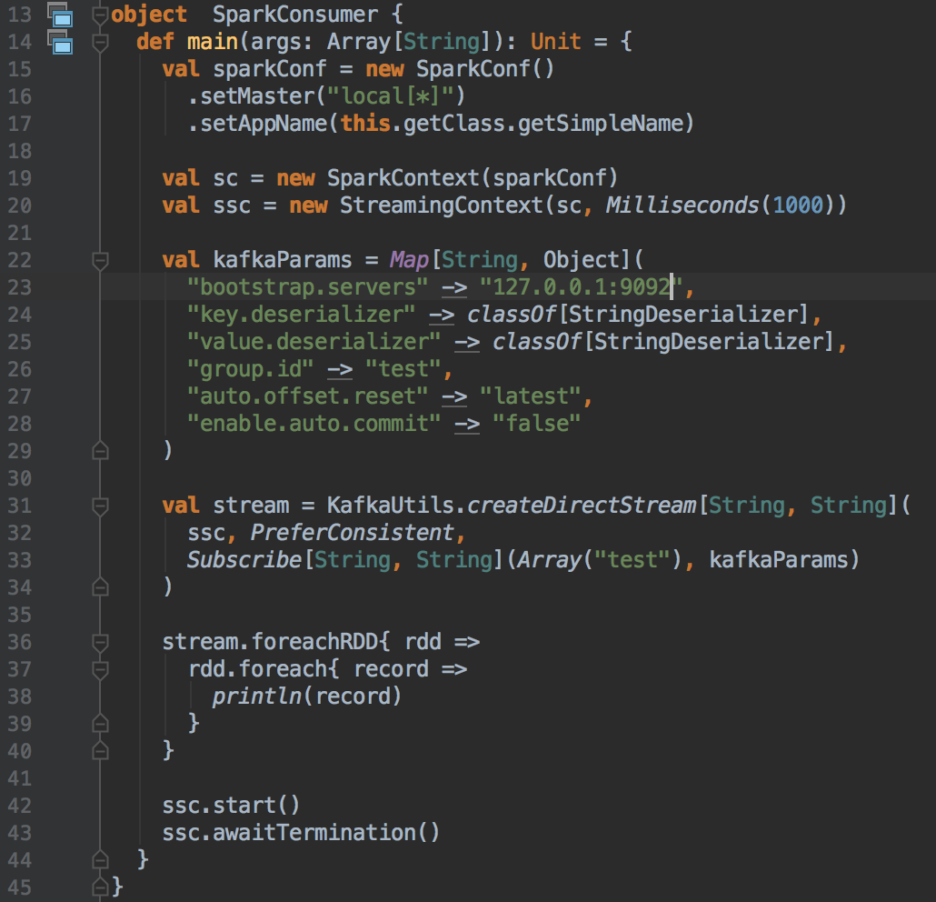
Scala Spark Streaming
Rdd to partiotion

Slide 21
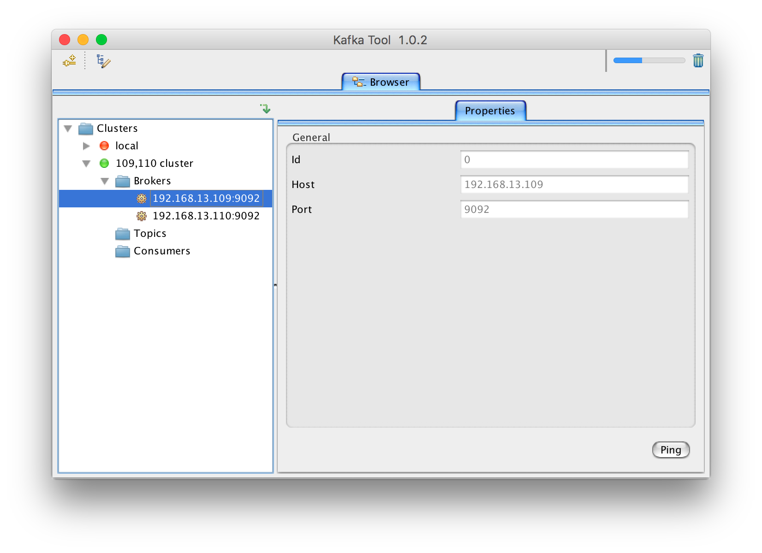
Multi-node cluster setup
Resources: 192.168.13.{109,110} servers
Change parameters on each node:
kafka/config/server.properties :
broker.id={x}
listeners = PLAINTEXT://{hostname}:9092
advertised.listeners = PLAINTEXT://{hostname}:9092
zookeeper.connect = {zookeeper_endpoint}:2181

Slide 22
Thank you for your attention!
Questions?
Code: https://github.com/vipmax/kafka_keynotes
Max Petrov
+79213676742
Notes:
More about kafka:
https://habr.com/company/skbkontur/blog/353204/

